Slide 1
Water, Life in Low Reynold’s Number
PBOC - Chapter12, Purcell, Nelson
Concepts to learn:
Viscosity
Viscous vs inertial forces
Low Reynolds number world
Effect on bacterial motility for example

Slide 2
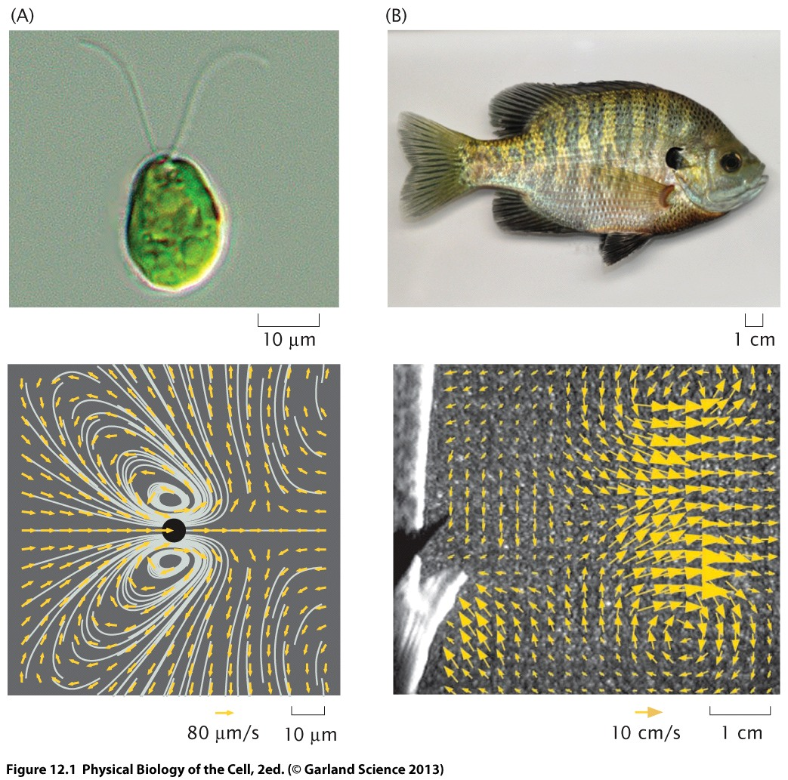
Chlamydomonus : 100um/sec
(with flagella)
Bluegill sunfish
FLOW flields
Very different length and velocity scales
Exquisite energetic efficiency – better than man-built vessels
Active swimmimg, chasing prey, avoiding predators – managing fluid dynamics – while competing for limited resources – selectable advantage
Organisms that have left the ocean and carry their own water – require control over the water’s movement as in blood circulation or rising sap in plants

Slide 3
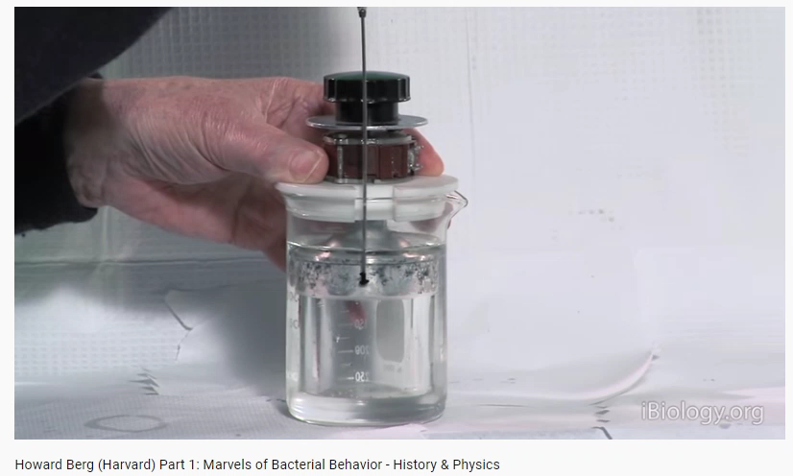

Slide 4
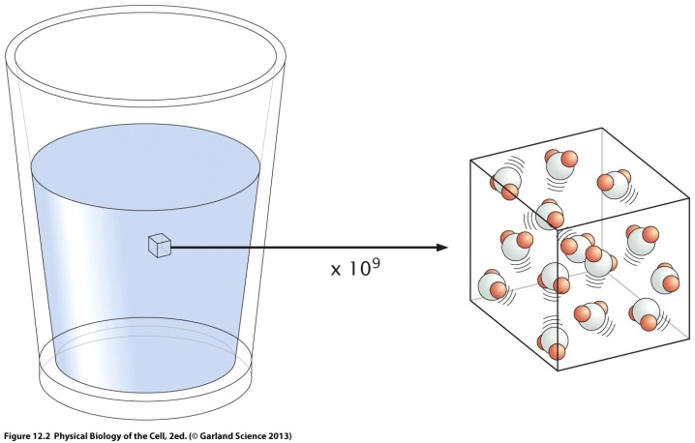
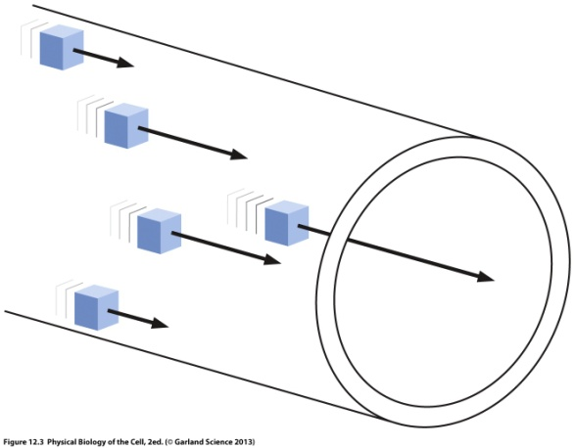
Water as continuum
v(r, t), ρ
Composed of molecules but can be treated as continuous medium
Solid vs Fluid: Fluids flow as a response to forces, solids get strained

Slide 5
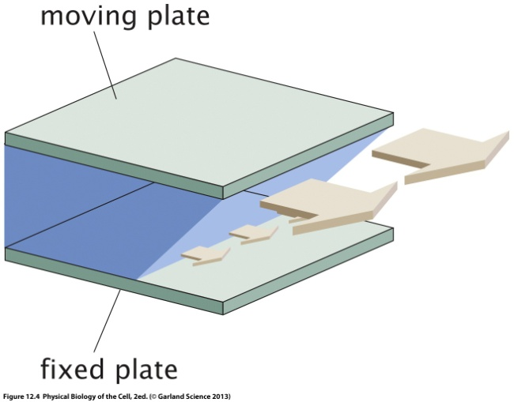
Viscosity
Newtonian Fluid
Smaller viscosity : bigger velocity gradients
Bigger viscosity” smaller velocity gradients
At the fixed plate: velocity = 0
For a given attained velocity, higher the viscosity of the fluid - bigger the force needed per unit area
Units: Pa.sec
Microscopic origin (?)
Feels like something that eats away energy – a dissipative term – hinders having two separate velocities in two adjacent fluid layers.
Fluid layers interact at interfaces. One, molecule can jam against each other; two they are continuously crossing one layer to the other.
Liquids: the jamming is relevant and can be overcome if temperature is increased hence jiggling unjams them. Viscosity decreases with temperature.
Gases: molecules are spaced apart very far away. No jamming but in fact momentum exchange due to collisions causes viscosity – hence increase in temperature increases viscosity.
Non-Newtonian Fluid : egg whites, mucus : can exhibit both fld-like and solid-like response to applied force

Slide 6
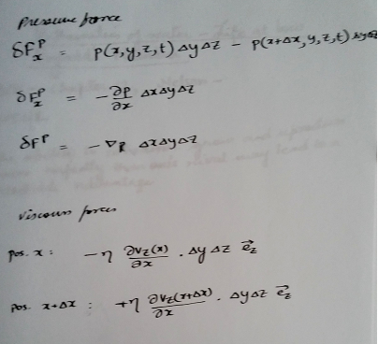
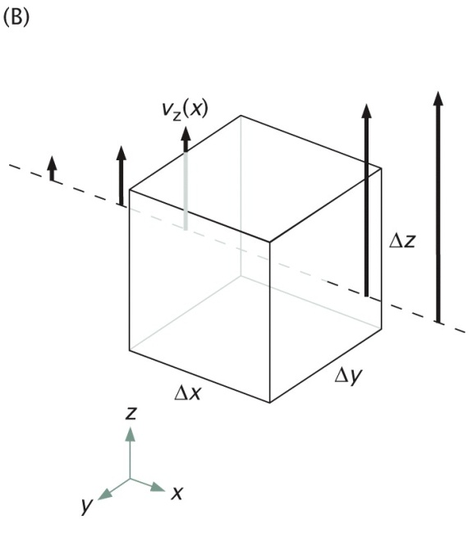
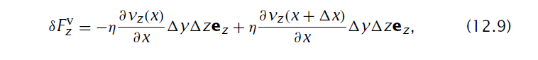
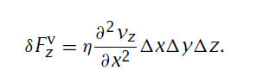
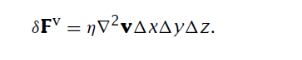
v=(0,0,v_{z}(x))
Viscous forces nonzero only on two faces perpendicular to x

Slide 7
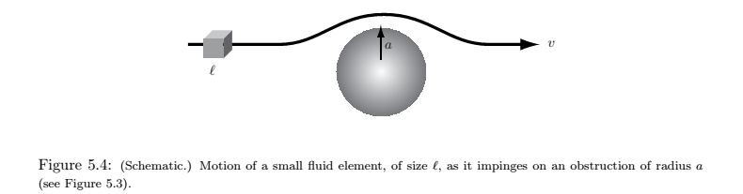
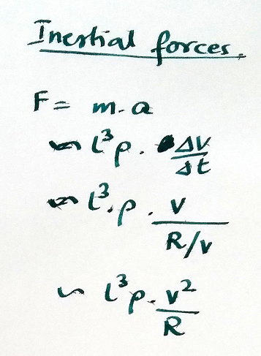
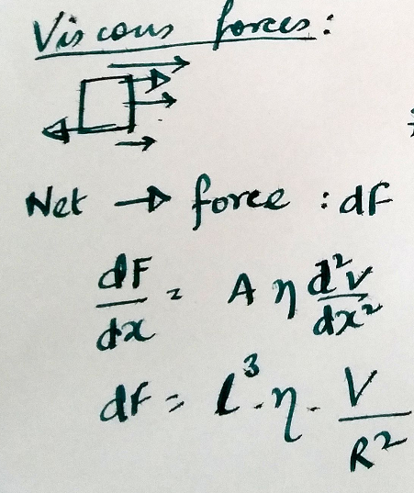
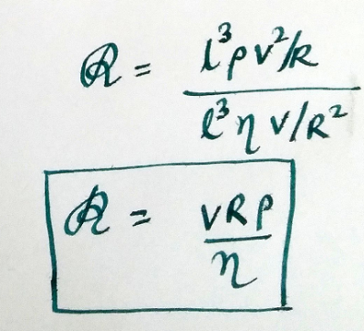
Reynold’s number
Dimensionless number:
Ratio of rough magnitudes of
Intertial/viscous forces
v

Slide 8
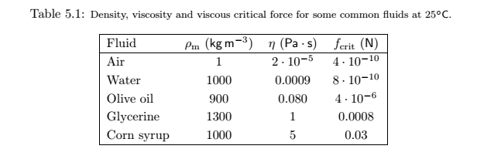
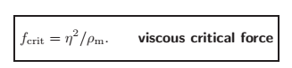
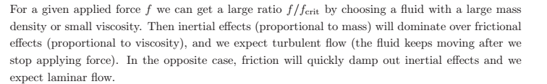
Force above which flow can turn turbulent
800 pN

Slide 9
Force above which flow can turn turbulent
800 pN

Slide 10
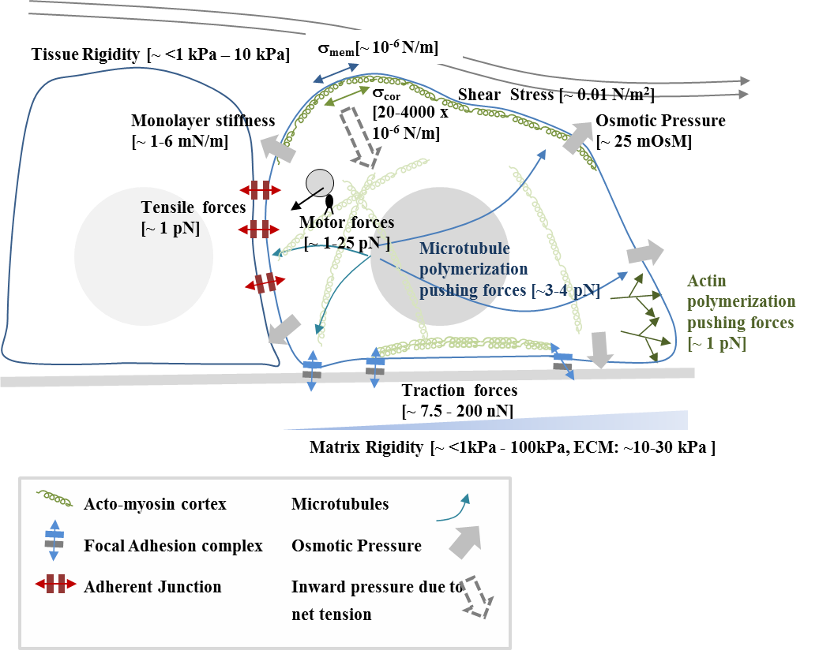



Forces in cells

Slide 11
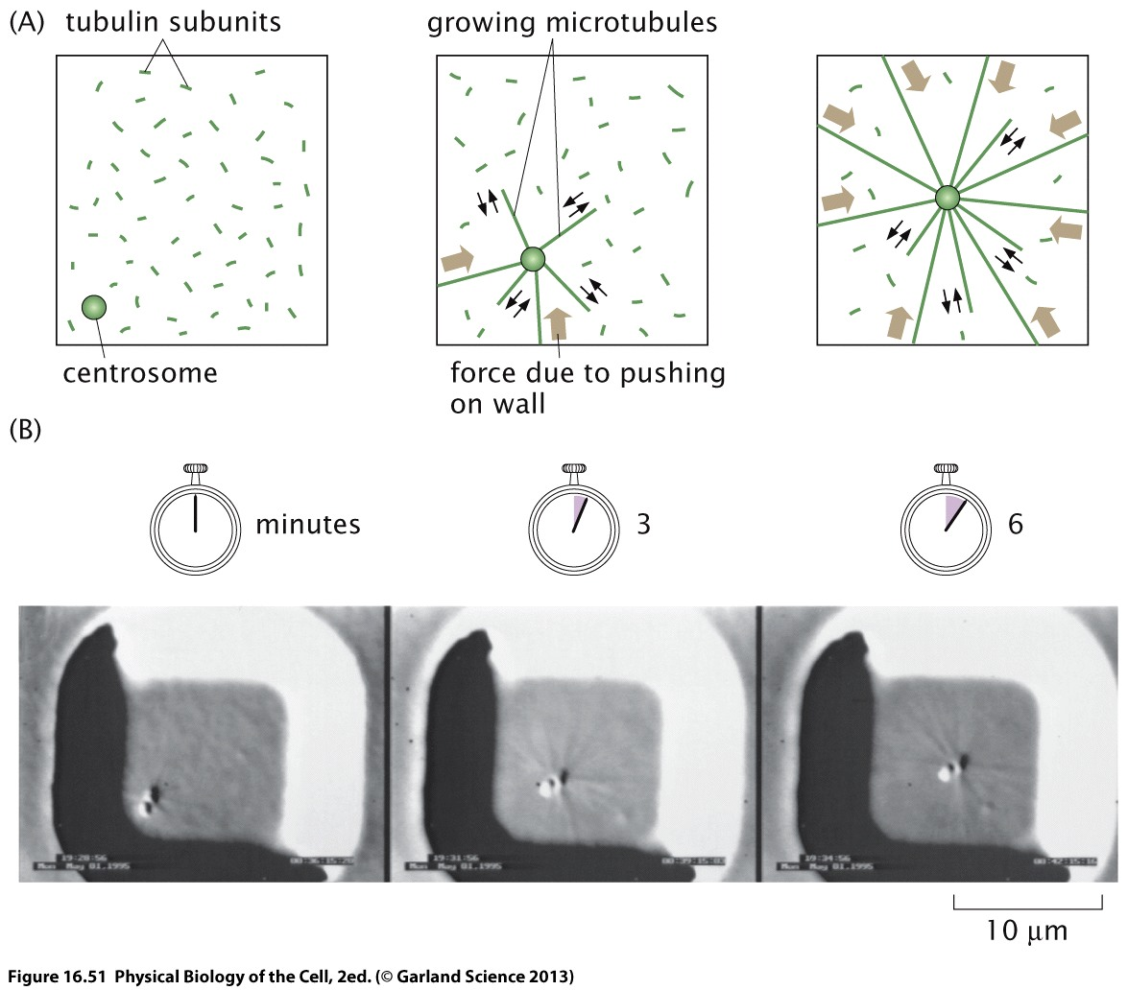
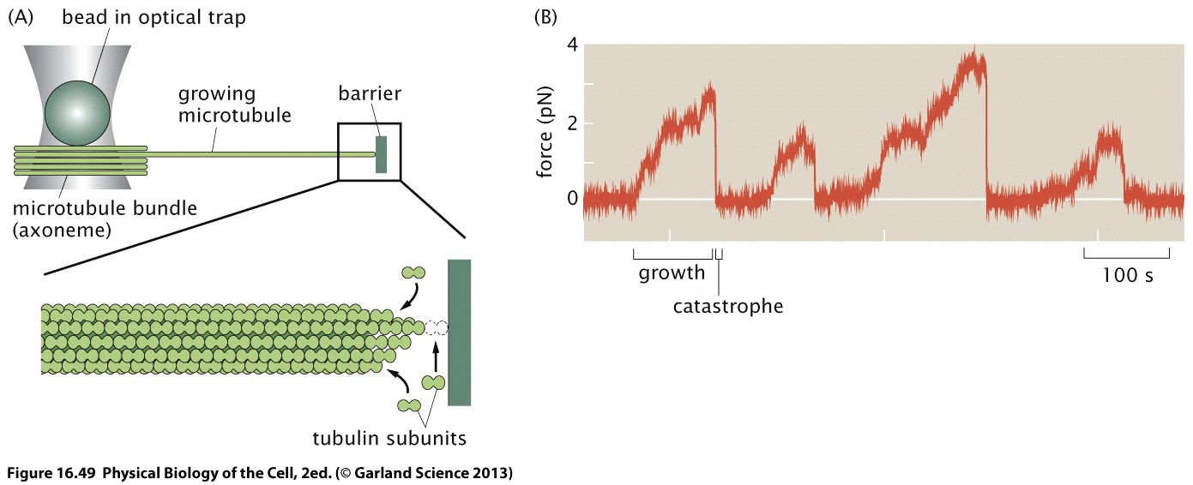
Finding centre of a cell using microtubule polymerization forces
Concept utilized in prokaryotes as well as eukaryotes

Slide 12
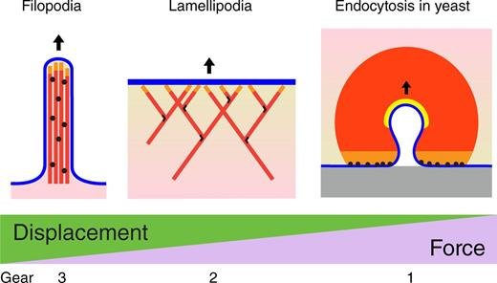
POLYMERIZATION FORCES
Review|March 21 2016
Amplification of actin polymerization forces
Serge Dmitrieff, François Nédélec
Author and Article Information
J Cell Biol (2016) 212 (7): 763–766.

Slide 13
Quoting Julie Theriot
Extra reading
“There has been a heroic attempt made by Eugene Koonin and colleagues to classify all of these many very divergent proteins into a reasonable phylogenetic tree based on sequence and structural similarities [97]. Given that this is such a diverse protein family spanning essentially the whole history of cellular evolution, there is some uncertainty here, but one thing about their reconstructed phylogeny really leapt out at me. According to their analysis, there is a entire branch of the P-loop NTPases that is found only in eukaryotes, and not in bacteria or archaea. This branch includes not only myosin and kinesin, but also many other critical proteins that we associate with eukaryotic cellular complexity. These include the Rho GTPase superfamily, which act as master regulators for actin cytoskeletal assembly [98], the Rab GTPases that govern many aspects of membraneous organelle identity [99], the Arf GTPases that are also associated with membrane traffic [100], the Ran GTPase that governs the directionality of nuclear import and export [101], and the heterotrimeric G proteins that influence so many aspects of eukaryotic cell-to-cell signaling [102]. So, wow. This looks very much like the list of eukaryotic-specific cellular features that we started off with.”
Why bacteria are different from eukaryotes? BMC Biology (2013)

Slide 14
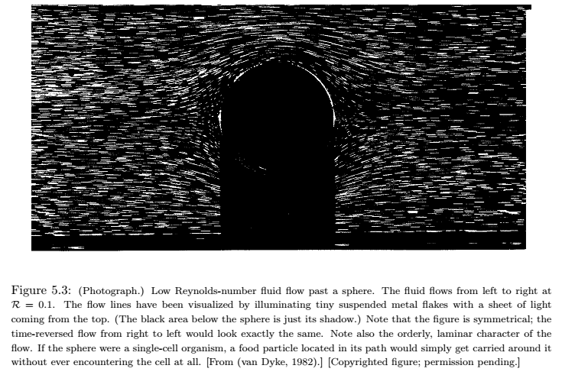

Slide 15
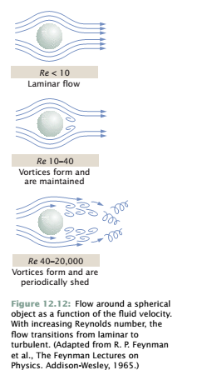
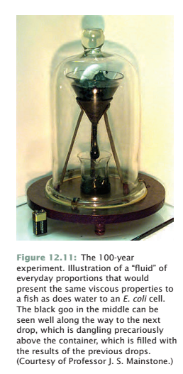
“pitch” – 9 drops in 86 years

Slide 16
Find the Reynold’s number for
Bacteria moving in water
Human swimming
Human cycling

Slide 17
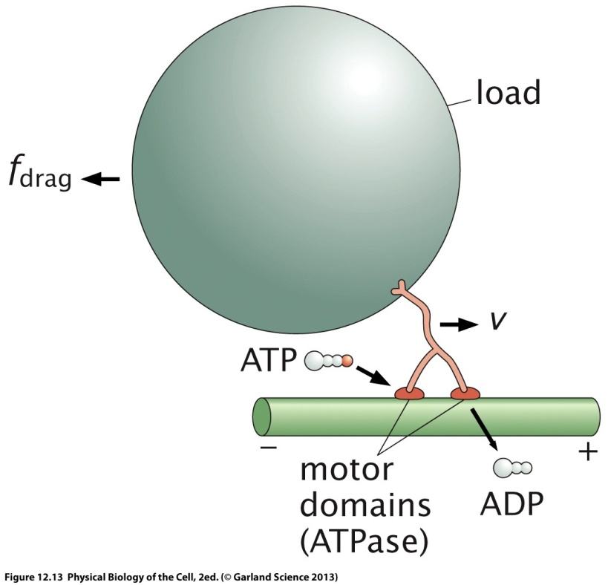
Drag force experienced by single molecules
Estimate the drag force experienced by a molecular motor (step size 8 nm) carrying a vesicle of radius 1 μm at a speed of 1 μm/sec. How does the energy consumed to drag a vesicle through one step compare with the 1 ATP hydrolysis that is used by the molecular motor of a single step (3 marks). Predict what would be the maximum force it could apply if it were use the energy of ATP hydrolysis.
Figure not to scale
STOKES LAW:

Slide 18
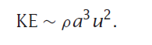
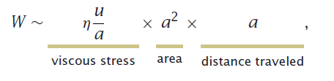
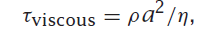
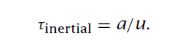
Coasting time
Time taken for the kinetic energy to be dissipated by viscous forces
=
Energy to be dissipated
Power used to dissipate
intertial
viscous
Power of viscous force:
( change to u to calculate power)
Time taken to move a distance comparable to its size
Calculate for bacteria, human

Slide 19
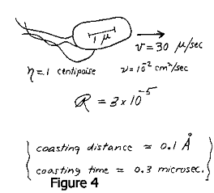
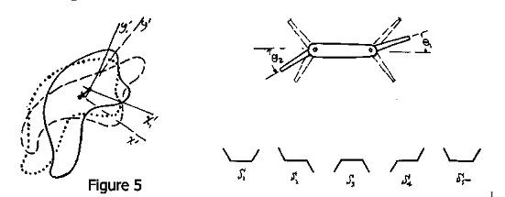

Slide 20
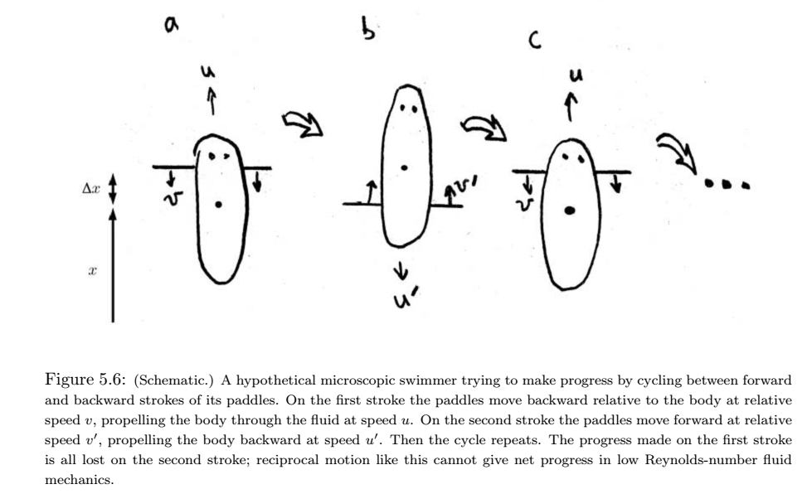

Slide 21
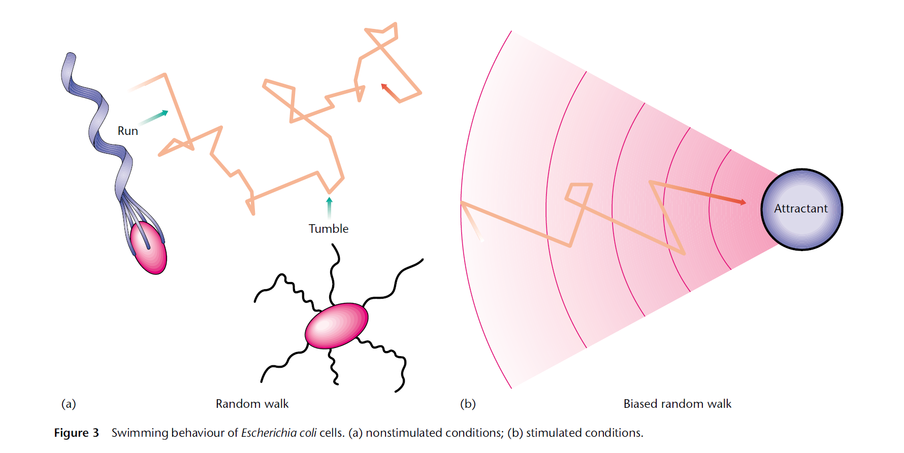
swimming

Slide 22
E. coli and other peritrichously flagellated bacteria swim by the action of rotary motors (usually two to six) embedded in the cell wall (2). The motors rotate counter-clockwise or clockwise, when viewed from behind the cell, with each motor driving a long, thin, left-handed helical flagellar filament. If all the motors rotate counter-clockwise in a viscous fluid (e.g., water), the flagella bundle together and propel the bacterial cell forward. This motion is called a “run”. If one or more motors rotate clockwise, the flagella unbundle, and the bacteria tumbles. The forward thrust generated by the flagellar bundle during a run is opposed by the translational viscous drag on the entire cell. Each flagellum (average length, ∼7 μm) rotates at speeds of ∼100 Hz (11,12) and its counter-clockwise rotation exerts a net torque on the cell body (average length, 2–5 μm). To balance this torque, the cell body counter-rotates in a clockwise direction (viewed from behind the organism) at speeds of ∼10 Hz (13)

Slide 23
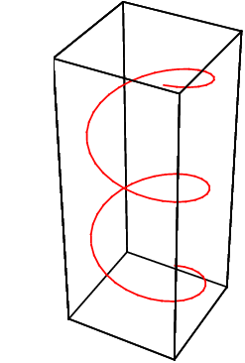
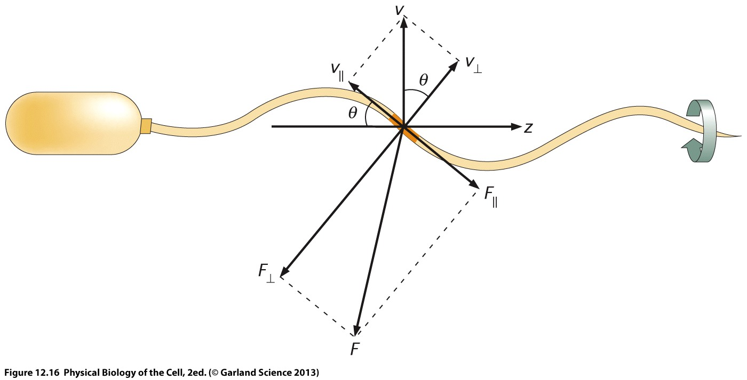
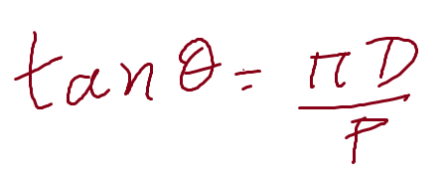

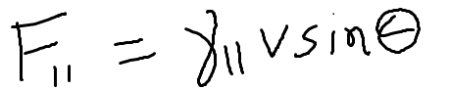
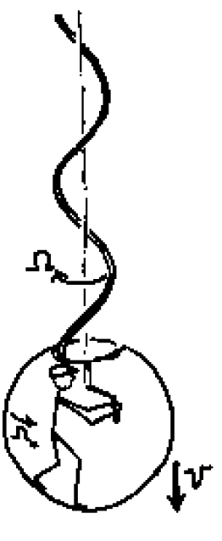


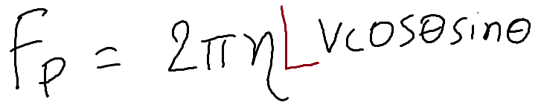

HOW BACTERIA PROPELS FORWARD..
For a thin rod
Filament length L= 10 μ m, D= 0.5 μ m, P=2 μm, f= 100 Hz,
Assume bacterial to be rod of length 10 μm, V_{bacteria}~30 μm/sec

Slide 24
Directions
F_{II} =2πηlvsin(θ)
v sin(θ)
θ
RHH
v
F⊥ =4πηlvcos(θ)
CCW
v
LHH
top

Slide 25
Directions
F_{II} =2πηlvsin(θ)
v sin(θ)
θ
RHH
v
F⊥ =4πηlvcos(θ)
CCW
v
LHH
top

Slide 26
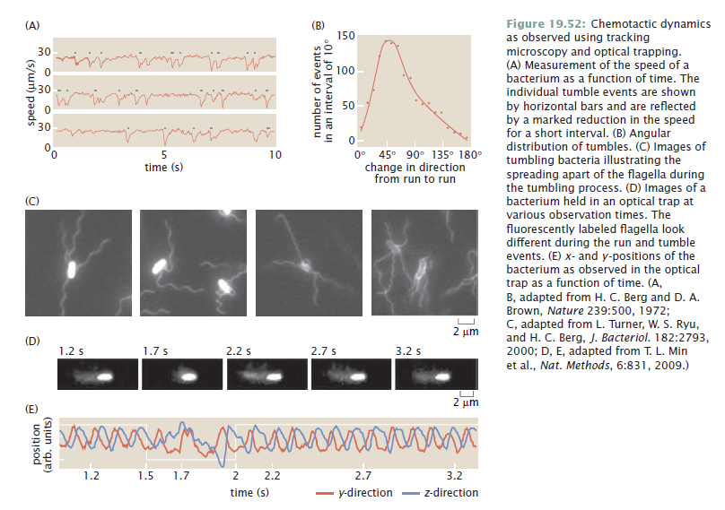

Slide 27
